Slide 1
Energy Signal & Power Signal

Slide 2
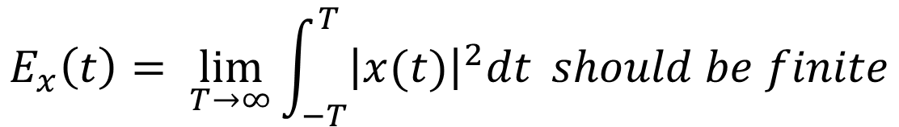

Energy Signal
A signal is referred to as an energy signal, if and only if the total energy of the signal satisfied the condition.
The value if Energy is in between 0 and infinity than such type of signal is known as Energy Signal.
The value of signal is finite than it is Energy Signal.
$$0<E<∞$$
$$Formula For Continuous Time Signal$$
$$E_{x}\left(t\right)= \lim_{T→∞}{\int_{−T}^{T}{{\left|x(t)\right|}^{2}dt} should be finite}$$

Slide 3
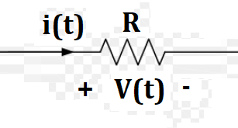
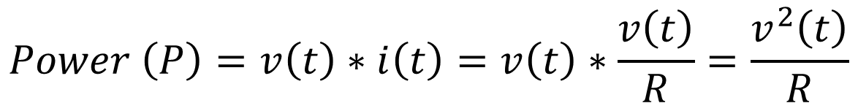

Energy Signal & Power Signal
$$Power \left(P\right)= i^{2}\left(t\right) OR$$
$$Power \left(P\right)=v\left(t\right)∗i\left(t\right)=v\left(t\right)∗\frac{v\left(t\right)}{R}=\frac{v^{2}\left(t\right)}{R}$$
$$Therefor, Power is a square of signal either voltage or current$$

Slide 4

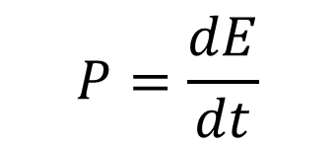
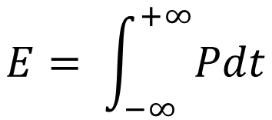

$${Example: For any signal is x\left(t\right), than its Power=P=x}^{2}\left(t\right)$$
$Power is the change in energy upon time$ $is called Power=P=\frac{dE}{dt}$
$$P=\frac{dE}{dt}$$
$$Pdt=dE$$
$$dE=Pdt,$$
$$So, dE is the small amount of Enenrgy, we required total energy, so$$
Integrate it on both sides
$$E= \int_{−∞}^{+∞}{Pdt}$$
Put the signal value of P = x²(t)
$$E= \int_{−∞}^{+∞}{Pdt=\int_{−∞}^{+∞}{x^{2}(t)dt=\int_{−∞}^{+∞}{{\left|x(t)\right|}^{2}dt, it is energy of signal }}}$$

Slide 5
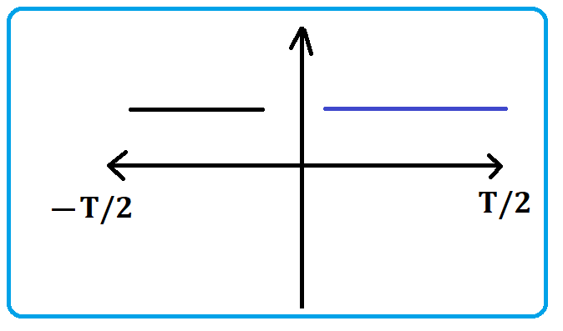
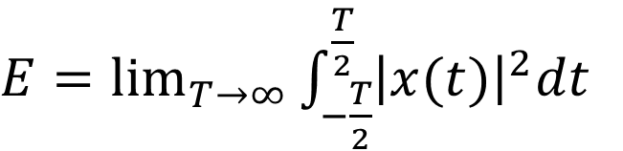
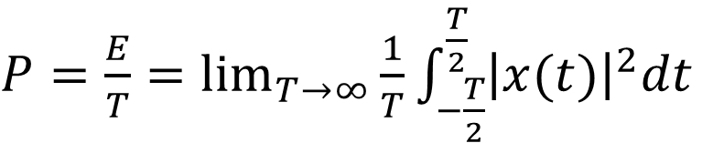
$$E= \int_{−∞}^{+∞}{Pdt=\int_{−∞}^{+∞}{x^{2}(t)dt=\int_{−∞}^{+∞}{{\left|x(t)\right|}^{2}dt, it is energy of signal }}}$$
Write above equation in another form
$E=\lim_{T→∞}{\int_{−\frac{T}{2}}^{\frac{T}{2}}{{\left|x(t)\right|}^{2}dt}}$
This is the Energy Formula
Now we calculate the Formula of Power, Power is the Energy (E) upon time (T)
T tends to infinity, so we used Limit T tends to infinity
$P=\frac{E}{T}=\lim_{T→∞}{\frac{1}{T}\int_{−\frac{T}{2}}^{\frac{T}{2}}{{\left|x(t)\right|}^{2}dt}}$
This is the Power Formula

Slide 6
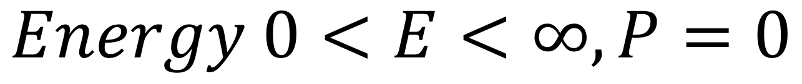
$$Energy 0<E<∞, P=0$$
$$Power= 0<P<∞, E→∞$$

Slide 7
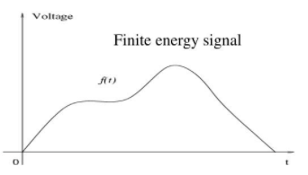
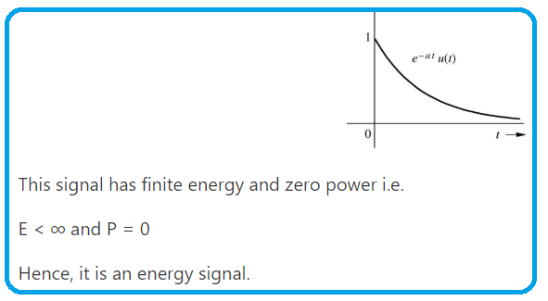
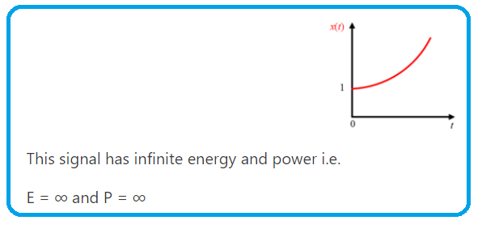
Energy Signal Should be Finite, Power has been Zero
Power = Energy/Time = finite(4)/Time(infinite) = 0

Slide 8
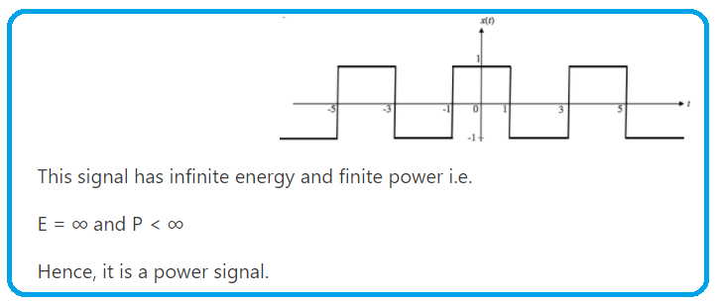
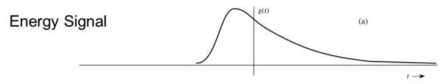
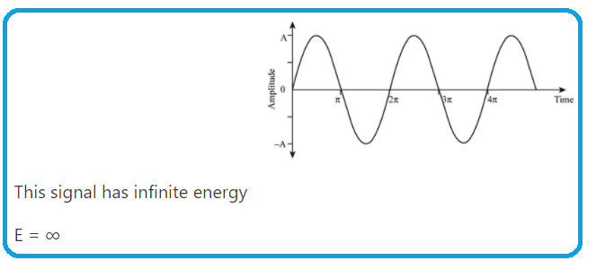
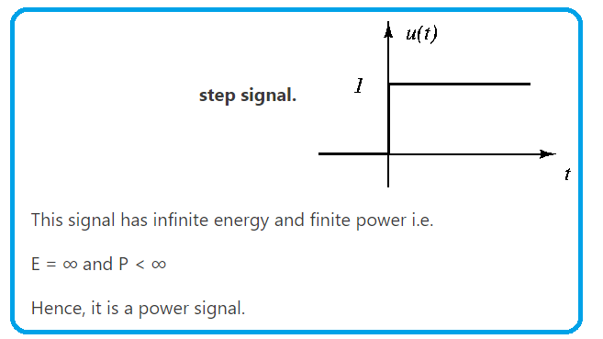
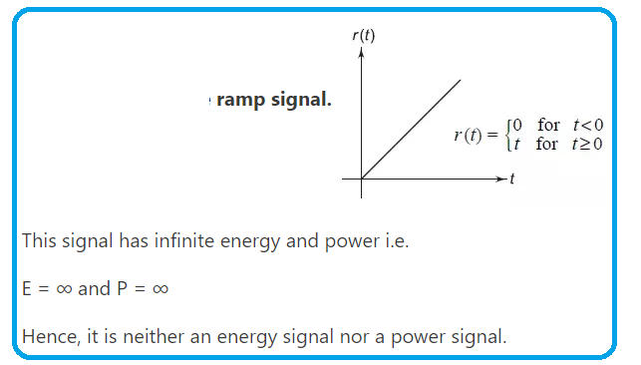
Energy Signal Should be Finite, Power has been Zero

Slide 9
Summary
Every periodic signal is a power signal.
Every power signal need not to be periodic.
Every energy signal is non-periodic.
Every non-periodic signal need not be an energy signal.
If signal Energy as well Power both infinite than signal is nothing energy and nothing power signal.

Slide 10
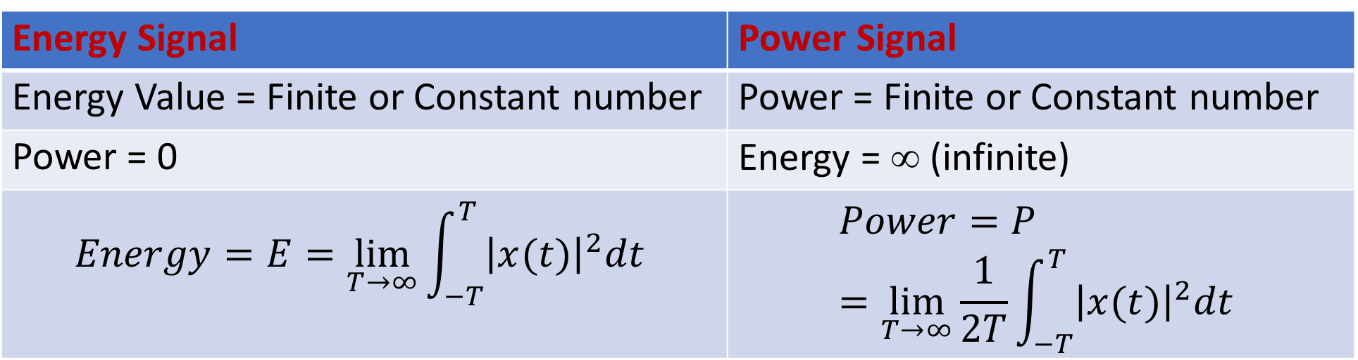
Energy Signal | Power Signal
Energy Value = Finite or Constant number | Power = Finite or Constant number
Power = 0 | Energy = ∞ (infinite)
$$Energy=E=\lim_{T→∞}{\int_{−T}^{T}{{\left|x(t)\right|}^{2}dt}}$$ | $$Power=P=\lim_{T→∞}\frac{1}{2T}{\int_{−T}^{T}{{\left|x(t)\right|}^{2}dt}}$$

Slide 11
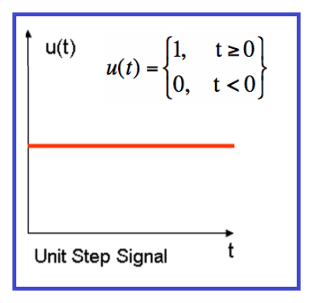
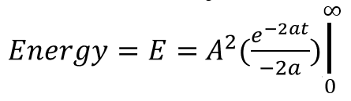
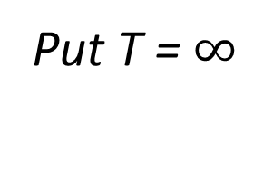
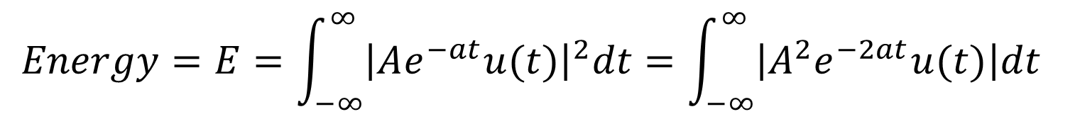

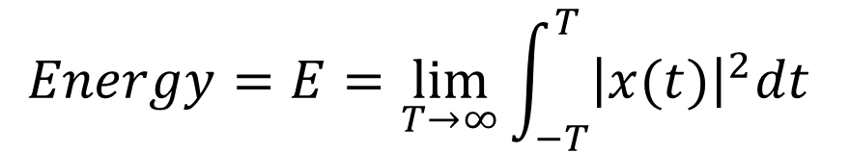

$$Q:Check whether following signals are Energy signal or Power Signal$$
$$1) x\left(t\right)=Ae^{−at}u(t)$$
$SOLUTION:$ First we apply Energy Formula and than we Apply Power Formula
$$Energy=E=\lim_{T→∞}{\int_{−T}^{T}{{\left|x(t)\right|}^{2}dt}}$$
Put T = $∞$
$$Energy=E=\int_{−∞}^{∞}{{\left|Ae^{−at}u(t)\right|}^{2}dt=\int_{−∞}^{∞}{\left|A^{2}e^{−2at}u(t)\right|dt }}$$
$Energy=E=\int_{0}^{∞}{\left|A^{2}e^{−2at}∗1\right|dt=\int_{0}^{∞}{A^{2}e^{−2at}dt=A^{2}\int_{0}^{∞}{e^{−2at}dt}}}$
$Energy=E=−\frac{1}{2a}A^{2}(e^{∞}−$ $e^{0})=−\frac{1}{2a}A^{2}\left(0−1\right)=\frac{A^{2}}{2a} , Constant Value$

Slide 12
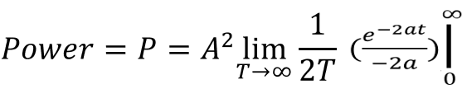
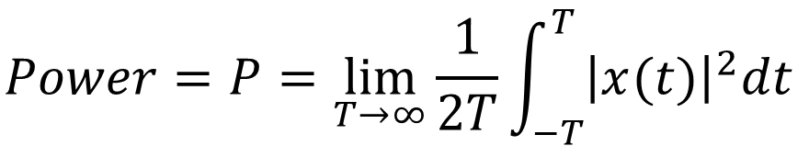
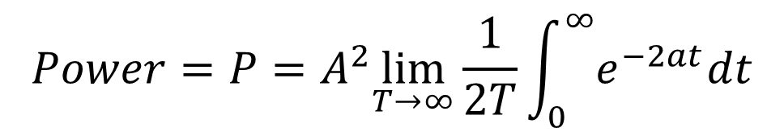
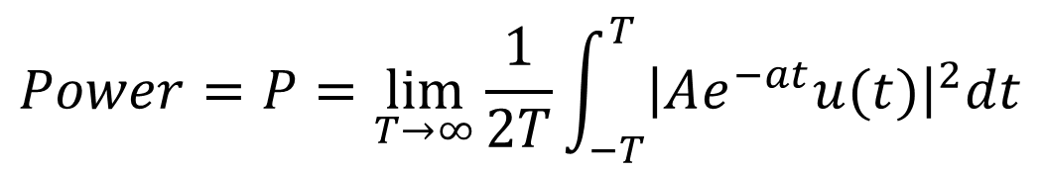
Now Apply Power Formula
$$Power=P=\lim_{T→∞}\frac{1}{2T}{\int_{−T}^{T}{{\left|x(t)\right|}^{2}dt}}$$
$$Power=P=\lim_{T→∞}\frac{1}{2T}{\int_{−T}^{T}{{\left|Ae^{−at}u(t)\right|}^{2}dt}}$$
$$Power=P=A^{2}\lim_{T→∞}\frac{1}{2T}{\int_{0}^{∞}{e^{−2at}dt}}$$
$Power=P=−\frac{1}{2a}A^{2}\frac{1}{2∗∞}(e^{∞}−$ $e^{0})=0, Power=0$
So, this signal is Energy Signal………………..Answer

Slide 13
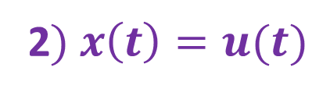
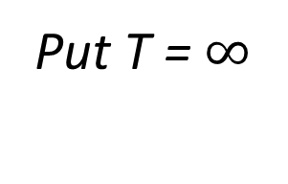

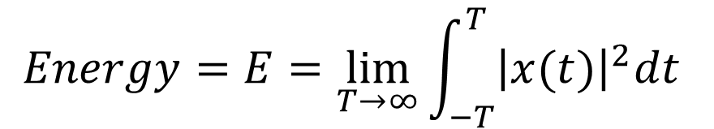
2$) x\left(t\right)=u(t)$
$SOLUTION:$ First we apply Energy Formula and than we Apply Power Formula
$$Energy=E=\lim_{T→∞}{\int_{−T}^{T}{{\left|x(t)\right|}^{2}dt}}$$
Put T = $∞$
$Energy=E=\int_{−∞}^{∞}{{\left|u(t)\right|}^{2}dt}=\int_{0}^{∞}{{\left|1\right|}^{2}dt}$ $=\int_{0}^{∞}{dt=\left(t\right)|_{0}^{∞}=\left(∞−0\right)=∞}$
$$Energy is infinity, it means it is power Signal$$
$Power=P=\lim_{T→∞}\frac{1}{2T}{\int_{−T}^{T}{{\left|x(t)\right|}^{2}dt}}=\lim_{T→∞}\frac{1}{2T}{\int_{−T}^{T}{{\left|u(t)\right|}^{2}dt=\lim_{T→∞}\frac{1}{2T}{\int_{0}^{T}{{\left|1\right|}^{2}dt}}= }}$ $\lim_{T→∞}\frac{1}{2T}{\int_{0}^{T}{dt=\lim_{T→∞}\frac{1}{2T}\left(t\right)|_{0}^{T}}}$
$$Power=P=\lim_{T→∞}\frac{1}{2T}\left(T−0\right)=\lim_{T→∞}\frac{1}{2}=\frac{1}{2} …Constant value$$
$$So, Energy value is infinite, and Power is finite or constant value$$
So, given signal is Power $Signal …….Answer$

Slide 14
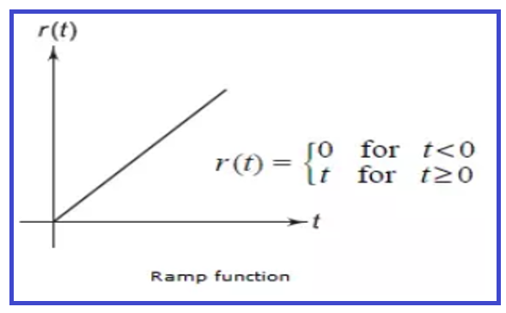
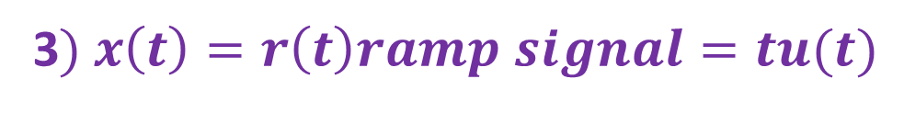
3$) x\left(t\right)=r\left(t\right)ramp signal=tu(t)$
$SOLUTION:$ First we apply Energy Formula and than we Apply Power Formula
$$Energy=E=\lim_{T→∞}{\int_{−T}^{T}{{\left|x(t)\right|}^{2}dt}}$$
Put T = $∞$
$Energy=E=\lim_{T→∞}\int_{−∞}^{∞}{{\left|tu(t)\right|}^{2}dt}=\lim_{T→∞}\int_{0}^{T}{t^{2}dt}$ $=\lim_{T→∞}\left[\frac{t^{3}}{3}\right]=\lim_{T→∞}\frac{1}{3}\left(T^{3}−0\right)=\lim_{T→∞}\left(\frac{T^{3}}{3}\right)=\left(\frac{∞^{3}}{3}\right)=∞$
$$Energy is infinity, it means it is power Signal$$
$$Power=P=\lim_{T→∞}\frac{1}{2T}{\int_{−T}^{T}{{\left|x(t)\right|}^{2}dt}}=\lim_{T→∞}\frac{1}{2T}{\int_{−T}^{T}{{\left|tu(t)\right|}^{2}dt=\lim_{T→∞}\frac{1}{2T}{\int_{0}^{T}{t^{2}dt}}=\lim_{T→∞}\frac{1}{2T}}}\left(\frac{t^{3}}{3}\right)|_{0}^{T}$$
$$Power=P=\lim_{T→∞}\frac{1}{2T}\left(\frac{T^{3}}{3}\right)=\lim_{T→∞}\frac{T^{2}}{6}=\frac{∞^{2}}{6}=∞$$
$$So, Given signal is neither Energy nor Power Signal…….Answer$$

